Slide 1


Slide 2

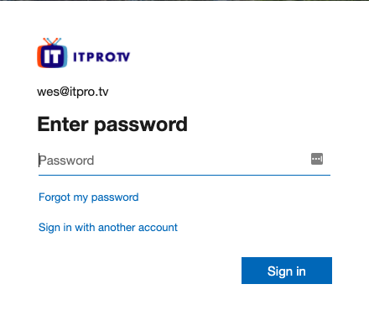
Online Attacks
Attacks against logon interface
Examples
Web portals
Terminal
Desktop logon

Slide 3



Online Attacks
Limited attempts
Bandwidth limits
Detectable

Slide 4
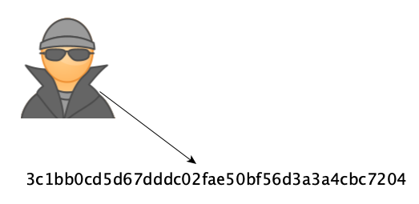
Offline Attacks
Attacking password directly
Obtain password hash

Slide 5
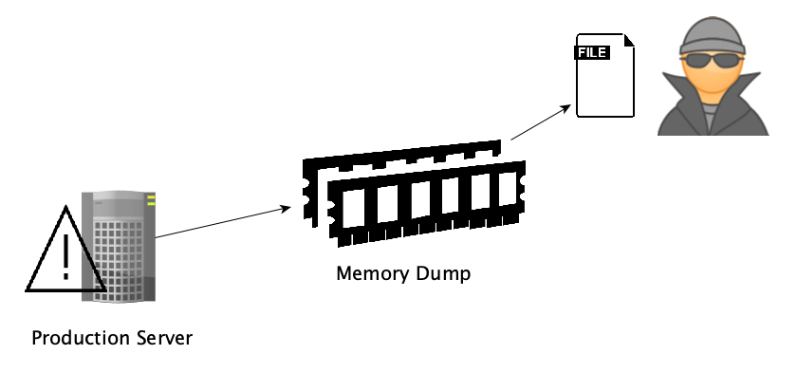
Offline Attacks
Memory Dump

Slide 6
Offline Attacks
Limited by processing power
Harder to detect

Slide 7
Password Attack Utilities
hashcat
Hydra
Medusa
John the Ripper
Notes:
John the Ripper - https://www.openwall.com/john/
Hashcat - https://hashcat.net/hashcat/ (offline)
Hydra - https://tools.kali.org/password-attacks/hydra (online)
medusa -u msfadmin -h 192.168.0.131 -P /usr/share/wordlists/fasttrack.txt -f -M ssh

Slide 8
Password Attack Utilities
PACK
CeWL
Statsprocessor
Burp Suite
Notes:
https://tools.kali.org/password-attacks/pack (assists password cracking tools)
CeWL - https://tools.kali.org/password-attacks/cewl (wordlist generator for password cracking)
Statsprocessor - https://hashcat.net/wiki/doku.php?id=statsprocessor (wordlist generator)
Burp Suite - https://portswigger.net/burp/communitydownload

